Slide 1
Hierarchical Clustering
Bhuvaneshwari Patil

Slide 2
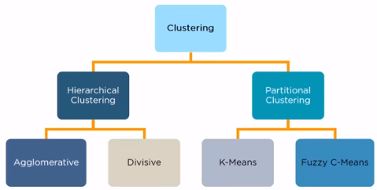
Clustering & types
– Unsupervised learning
– Requires data, but no labels
– Detect patterns e.g. in
• Group emails or search results
• Customer shopping patterns
• Regions of images
– Useful when don’t know what you’re looking for
– But: can get gibberish

Slide 3

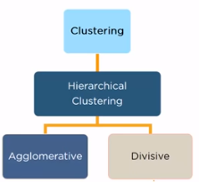
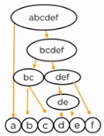
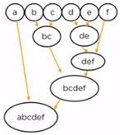


Hierarchical Clustering
Clusters have a tree like structure
Has a parent child relationship

Slide 4
Hierarchical clustering types
Hierarchical clustering algorithm is of two types:
i) Agglomerative Hierarchical clustering algorithm or AGNES (agglomerative nesting) and
ii) Divisive Hierarchical clustering algorithm or DIANA

Slide 5
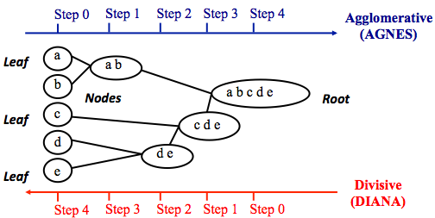
Hierarchical clustering
Note that, agglomerative clustering is good at identifying small clusters. Divisive clustering is good at identifying large clusters

Slide 6
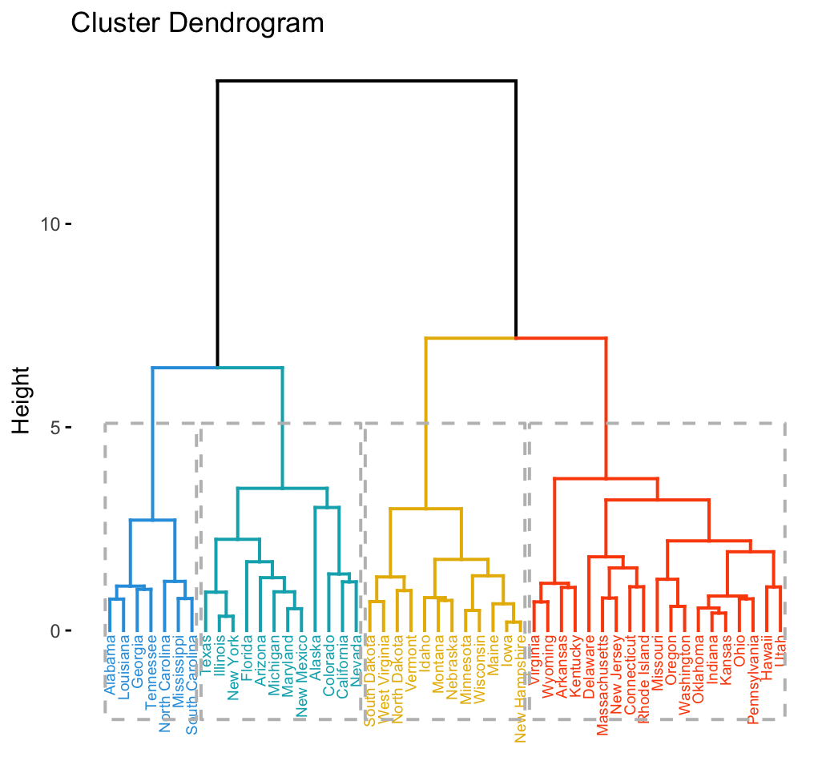
Dendogram
Dendrograms correspond to the graphical representation of the hierarchical tree

Slide 7
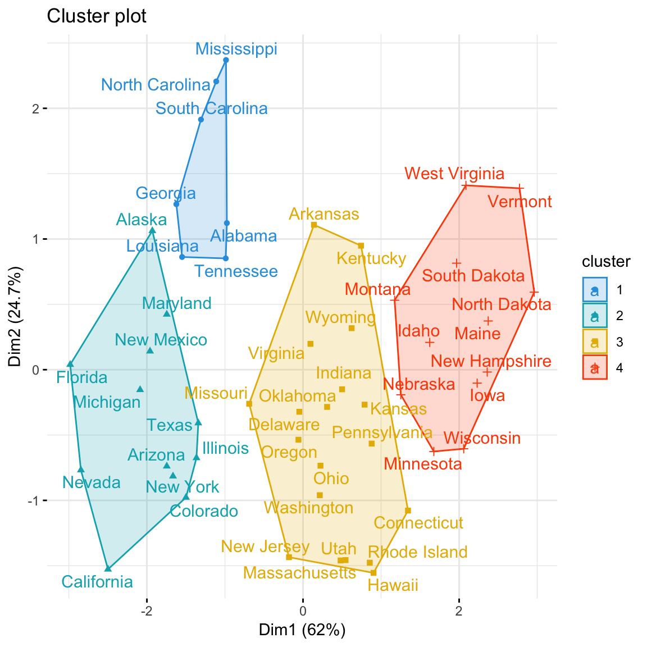

Slide 8
AGNES
Agglomerative

Slide 9
Agglomerative Hierarchical clustering
This algorithm works by grouping the data one by one on the basis of the nearest distance measure of all the pairwise distance between the data point.
The distance between the data point is recalculated but which distance to consider when the groups has been formed? For this there are many available methods. Some of them are:
single-nearest distance or single linkage
complete-farthest distance or complete linkage
average-average distance or average linkage
centroid distance
ward's method - sum of squared Euclidean distance is minimized
This way we go on grouping the data until one cluster is formed
Now on the basis of dendogram graph we can calculate how many number of clusters should be actually present.

Slide 10
How They Work!
Given a set of N items to be clustered, and an N*N distance (or similarity) matrix, the basic process of hierarchical clustering (defined by S.C. Johnson in 1967) is this:
Start by assigning each item to a cluster, so that if you have N items, you now have N clusters, each containing just one item.
Let the distances (similarities) between the clusters the same as the distances (similarities) between the items they contain.
Find the closest (most similar) pair of clusters and merge them into a single cluster, so that now you have one cluster less.
Compute distances (similarities) between the new cluster and each of the old clusters.
Repeat steps 2 and 3 until all items are clustered into a single cluster of size N. (*)
Step 3 can be done in different ways, which is what distinguishes single-linkage from complete-linkage and average-linkage clustering.

Slide 11
Types of Agglomerative method
Maximum or complete linkage: The distance between two clusters is defined as the maximum value of all pairwise distances between the elements in cluster 1 and the elements in cluster 2. It tends to produce more compact clusters.
Minimum or single linkage: The distance between two clusters is defined as the minimum value of all pairwise distances between the elements in cluster 1 and the elements in cluster 2. It tends to produce long, “loose” clusters.
Mean or average linkage: The distance between two clusters is defined as the average distance between the elements in cluster 1 and the elements in cluster 2.
Centroid linkage: The distance between two clusters is defined as the distance between the centroid for cluster 1 (a mean vector of length p variables) and the centroid for cluster 2.
Ward’s minimum variance method: It minimizes the total within-cluster variance. At each step the pair of clusters with minimum between-cluster distance are merged.
This kind of hierarchical clustering is called agglomerative because it merges clusters iteratively
once you have got the complete hierarchical tree, if you want k clusters you just have to cut the k-1 longest links.

Slide 12
Algorithmic steps for Agglomerative Hierarchical clustering
Let X = {x₁, x₂, x₃, ..., x_{n}} be the set of data points
1) Begin with the disjoint clustering having level L(0) = 0 and sequence number m = 0.
2) Find the least distance pair of clusters in the current clustering, say pair (r), (s), according to d[(r),(s)] = min d[(i),(j)] where the minimum is over all pairs of clusters in the current clustering.
3) Increment the sequence number: m = m +1
Merge clusters (r) and (s) into a single cluster to form the next clustering m. Set the level of this clustering to
L(m) = d[(r),(s)]
4) Update the distance matrix, D, by deleting the rows and columns corresponding to clusters (r) and (s) and adding a row and column corresponding to the newly formed cluster.
The distance between the new cluster, denoted (r,s) and old cluster(k) is defined in this way:
d[(k), (r,s)] = min (d[(k),(r)], d[(k),(s)]).
5) If all the data points are in one cluster then stop, else repeat from step 2).

Slide 13
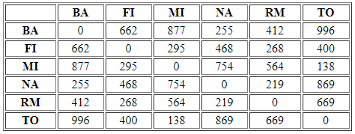
An Example
A hierarchical clustering of distances in kilometers between some Italian cities. The method used is single-linkage.
Input distance matrix (L = 0 for all the clusters):
http://home.deib.polimi.it/matteucc/Clustering/tutorial_html/hierarchical.html

Slide 14
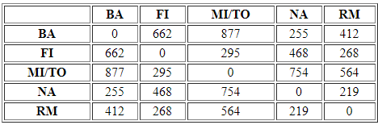
The nearest pair of cities is MI and TO, at distance 138
The level of the new cluster is L(MI/TO) = 138 and the new sequence number is m = 1.
Then we compute the distance from this new compound object to all other objects

Slide 15
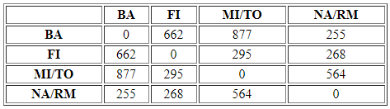
min d(i,j) = d(NA,RM) = 219 => merge NA and RM into a new cluster called NA/RM
L(NA/RM) = 219
m = 2

Slide 16
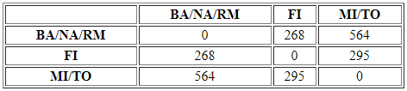
min d(i,j) = d(BA,NA/RM) = 255 => merge BA and NA/RM into a new cluster called BA/NA/RM
L(BA/NA/RM) = 255
m = 3

Slide 17

min d(i,j) = d(BA/NA/RM,FI) = 268 => merge BA/NA/RM and FI into a new cluster called BA/FI/NA/RM
L(BA/FI/NA/RM) = 268
m = 4
Finally, we merge the last two clusters at level 295.

Slide 18
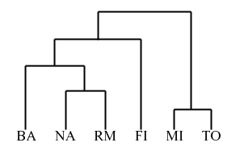
Summary

Slide 19
Advantages
No apriori information about the number of clusters required.
Easy to implement and gives best result in some cases.
http://home.deib.polimi.it/matteucc/Clustering/tutorial_html/hierarchical.html

Slide 20
Disadvantages
Algorithm can never undo what was done previously.
Time complexity of at least O(n² log n) is required, where ‘n’ is the number of data points.
Based on the type of distance matrix chosen for merging different algorithms can suffer with one or more of the following:
Sensitivity to noise and outliers
Breaking large clusters
Difficulty handling different sized clusters and convex shapes
No objective function is directly minimized
Sometimes it is difficult to identify the correct number of clusters by the dendogram.

Slide 21
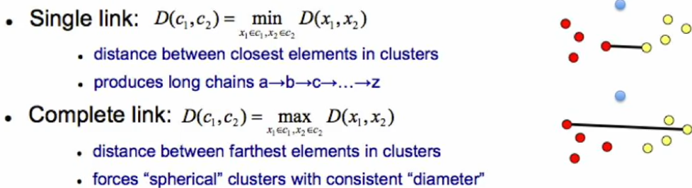
Single link vs. complete link

Slide 22
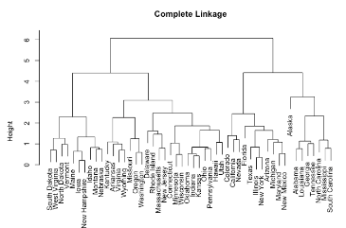
Maximum or complete linkage clustering: Computes all pairwise dissimilarities between the elements in cluster 1 and the elements in cluster 2, and considers the largest value of these dissimilarities as the distance between the two clusters. It tends to produce more compact clusters

Slide 23
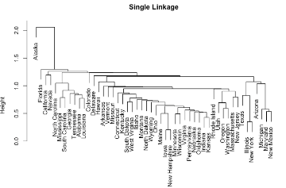
Minimum or single linkage clustering: Computes all pairwise dissimilarities between the elements in cluster 1 and the elements in cluster 2, and considers the smallest of these dissimilarities as a linkage criterion. It tends to produce long, “loose” clusters.

Slide 24
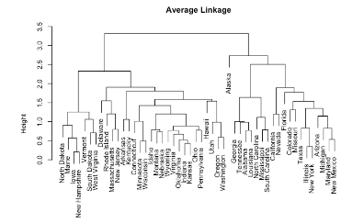
Mean or average linkage clustering: Computes all pairwise dissimilarities between the elements in cluster 1 and the elements in cluster 2, and considers the average of these dissimilarities as the distance between the two clusters. Can vary in the compactness of the clusters it creates

Slide 25
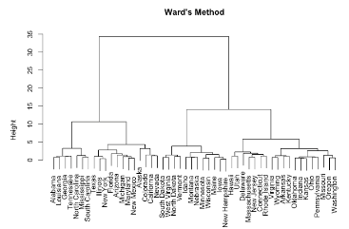
Ward’s minimum variance method: Minimizes the total within-cluster variance. At each step the pair of clusters with the smallest between-cluster distance are merged. Tends to produce more compact clusters.

Slide 26
DIANA
Divisive Analysis

Slide 27
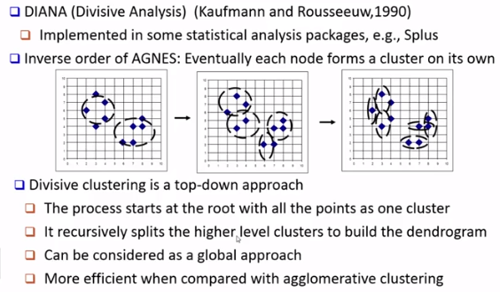
Introduction

Slide 28
Reference for DIANA
https://books.google.co.in/books?id=ZXLSVPN1X1sC&pg=PA146&lpg=PA146&dq=chapter+6+of+Kaufman+and+Rousseeuw+(1990)&source=bl&ots=lqgaN_96WY&sig=ACfU3U1kDiQYh9COEsODdQvaFOSPFiTGEQ&hl=en&sa=X&ved=2ahUKEwiSiveb6tLpAhX3wjgGHS7iDMwQ6AEwBnoECAgQAQ#v=onepage&q=chapter%206%20of%20Kaufman%20and%20Rousseeuw%20(1990)&f=false
Divisive Analysis (DIANA) of hierarchical clustering and GPS data for level of service criteria of urban streets
Ashish Kumar Patnaik a,*, Prasanta Kumar Bhuyan a,1, K.V. Krishna Rao
diana is fully described in chapter 6 of Kaufman and Rousseeuw (1990)

Slide 29
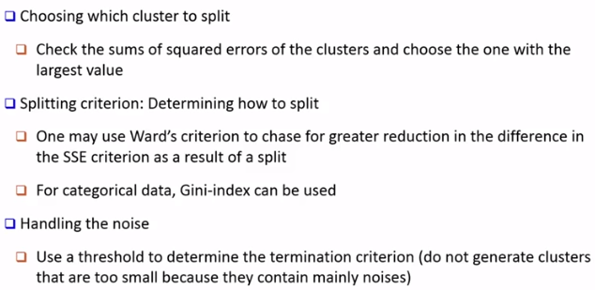
Split criteria

Slide 30
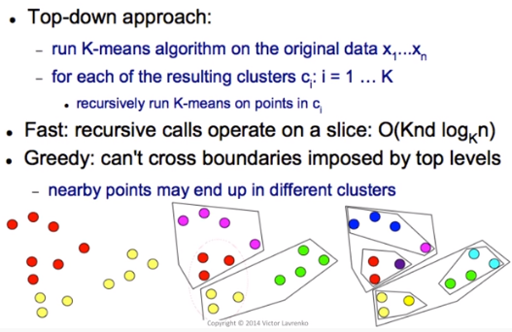
Simplest Algorithm to split

Slide 31
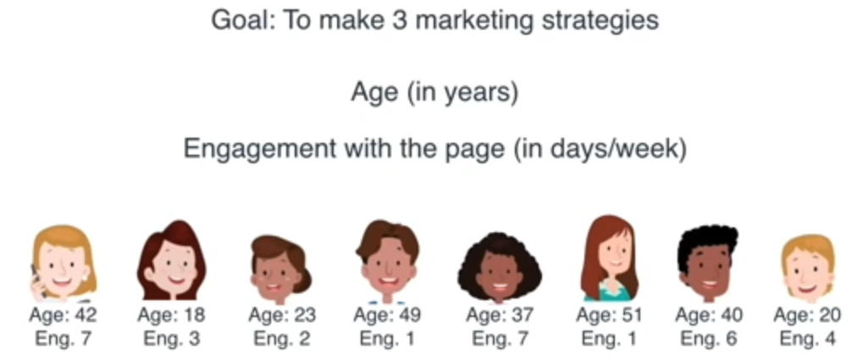
Customer clustering

Slide 32
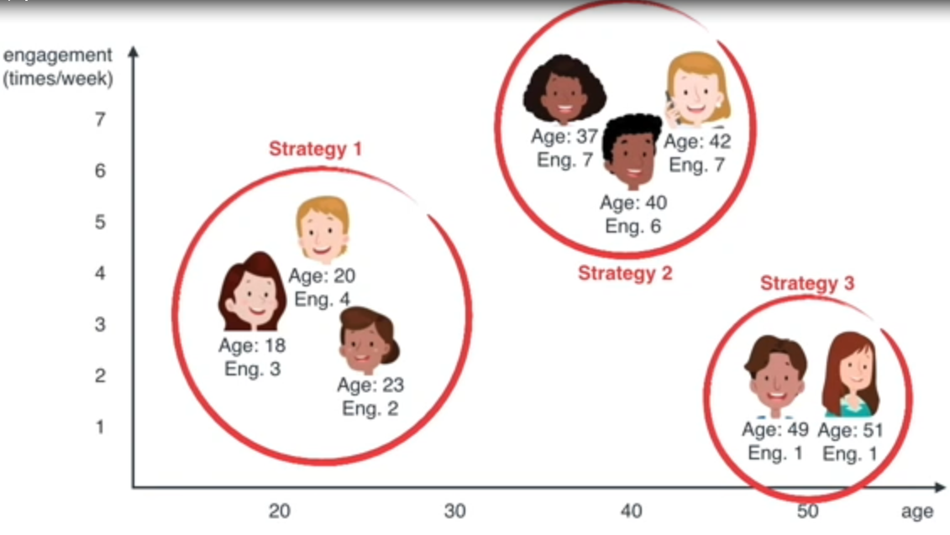
Data plot

Slide 33
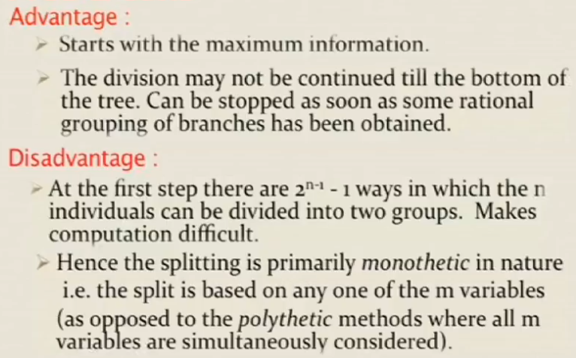
Pros and cons

Slide 34
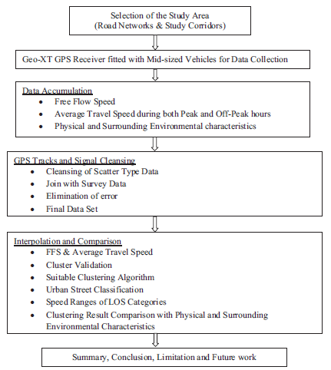
An example Level of Service (LOS) for heterogeneous traffic flow on urban streets

Slide 35
Algorithm steps
Step-1: The DIANA clustering is followed by Agglomerative Hierarchical Clustering up to the cluster contains all the objects. Then the Divisive Analysis Clustering (DIANA) follows the top-down approach assuming it single cluster having level L (0) =n and sequence number m= 0.
Step-2: The most dissimilar pair of clusters in the current cluster is found out; that is (r), (s) in which d [(r), (s)] =min d [(i), (j)], where min is the complete pairs of cluster in the current cluster.
Step-3: The sequence number is incremented in the manner m= m+ 1. The cluster is broken into clusters (r) and (s) to form next cluster to make the level of clustering: L (m1) =d [(r)] and L (m2)= d [(s)].
Step-4: The distance matrix (D) is updated by adding the rows and columns corresponding to clusters (r) and (s). The similarity between the new cluster, denoted by (r, s) and old cluster (k) is defined in this way:
If all objects are distinct clusters, then stop; otherwise proceed to step-2.

Slide 36
Numerical example
consider a sample data set x, made up of six objects, say average free flow speed (ffs) values in kmph on six street segments. The data set can be defined as a matrix
x = [ffs1; ffs2; ffs3; ffs4; ffs5; ffs6]
=[85.00,92.56, 72.85, 50.66, 39.89, 38.58]

Slide 37
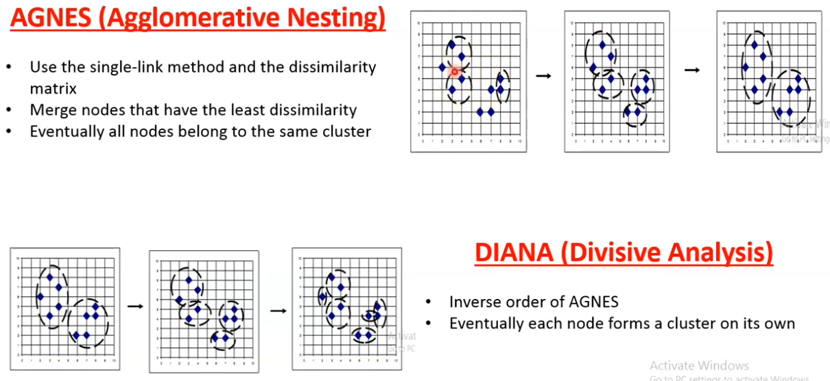
AGNES vs. DIANA

Slide 38
Optimal number of clusters?

Slide 39
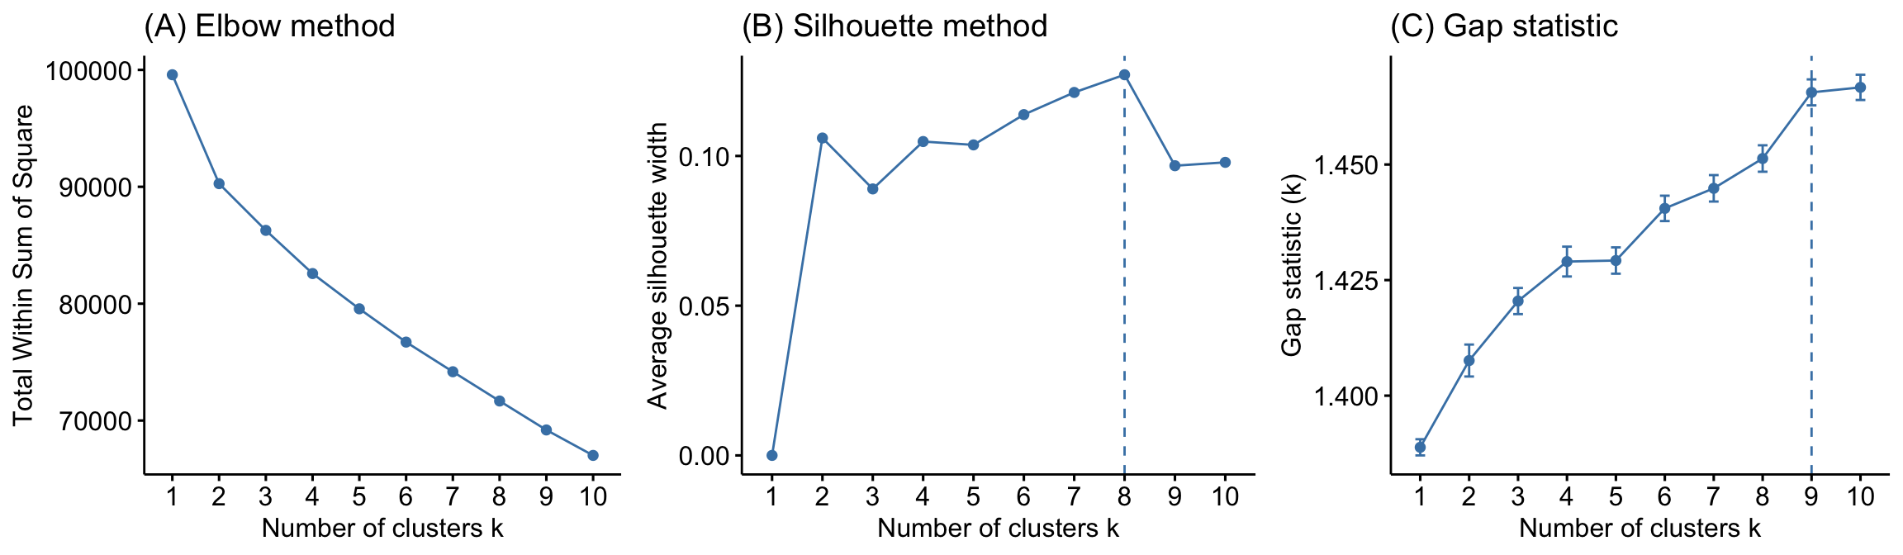
Comparison of three different methods to identify the optimal number of clusters

Slide 40
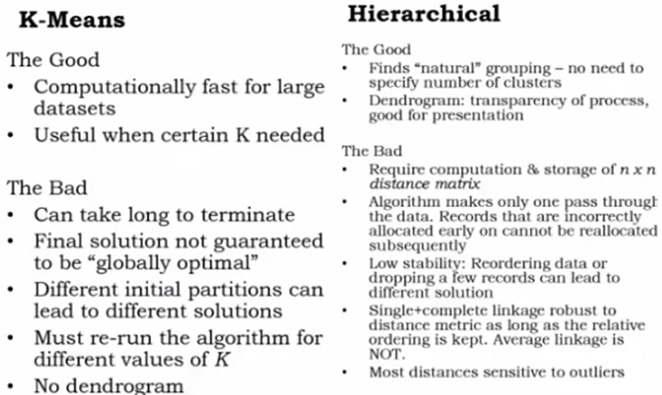
K-means vs. Hierarchical

